Slide 1
Food Order System
Doughnut Store
Henry, Kaleem, Ivo and Lukman

Slide 2
Food Order System
Sections
Requirements Analysis
Design
User Acceptance
Team working Strategy

Slide 3
Requirements

Slide 4
Requirements
Our process
Split Sections
Noted down ideas within each section
Expanded points and provided evidence

Slide 5
Requirements
Stakeholders
Customer
Chef
Driver/Checkout Staff
Admin

Slide 6
Requirements
Non-Functional
Product
Speed
Navigable
Functional on both desktop and mobile
Organisational
Companies typeface and colour scheme
Receipt of purchase
External
GDPR

Slide 7
Requirements
Functional - Customer Site
Ordering food from website
Storing Customer accounts
Payment For Orders
Viewing previous orders

Slide 8
Requirements
Functional - Store Site
Chefs and view current orders
Customer details
Confirming Completion
Amending menu items
Add/ Remove menu items

Slide 9
Requirements
Use Cases
Customer
Order Food
Chef
View Order
Driver/Checkout Staff
Complete Order
Admin
Amend Item
Add item
Remove Item

Slide 10
Design

Slide 11
Design
Problems With Existing System
Long winded Process
Unable to see a copy of the menu when ordering
No validation possible that the items were sent to the correct address

Slide 12
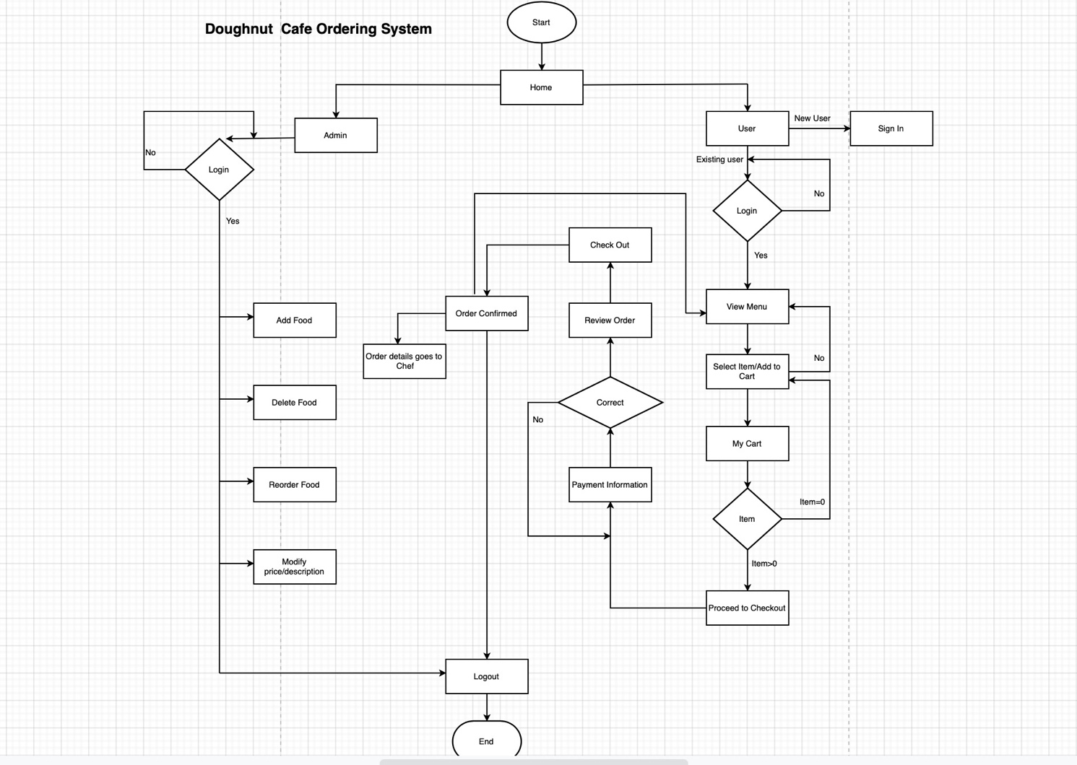
Design
Flow Chart for the Ordering Process in the New System

Slide 13
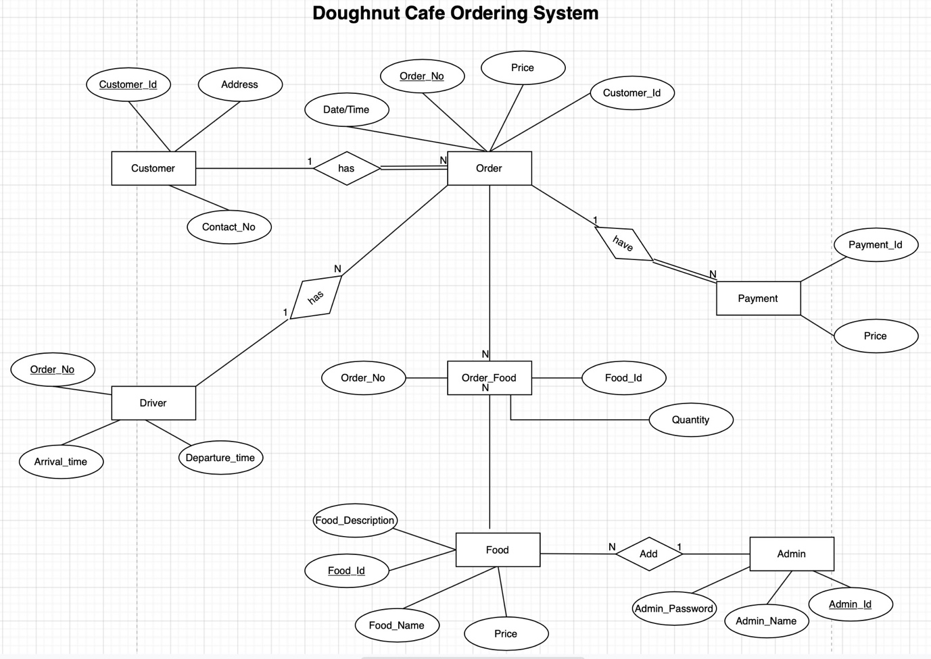
Design
ER Diagram for the New System

Slide 14
User Acceptance Criteria

Slide 15
User Acceptance Criteria
System Requirements | How were going to test it? | Why?
Update website design | Yes, or no? | This does not require a test because you can easily identify if the website has been updated.
Include company TypeFace and Colour Scheme | Yes, or no? | This does not require a test because you can see if we have implemented the FaceType and Colour Scheme to the website
Simplify user experience | We will create a survey and ask current customers to take the survey and answer it, this survey will have questions about if the user experience has become simpler. | We have chosen to test it with a survey because it allows us to get feedback from current customers.
Improve user experience | We will create a survey and ask current customers to take the survey and answer it, this survey will have questions about if the user experience has been improved. | We have chosen to test it with a survey because it allows us to get feedback from current customers.
Food ordering system | We will test this by making test orders and test every product to make sure they can be purchased using the ordering system. | We have chosen this method because it is simple and can be done during the development process.

Slide 16
User Acceptance Criteria
Store customer details | We will test this by adding fake customer information such as email, name, etc and see if it works. | This method has been chosen because it can be done during the development phase.
Users can create accounts | We will test this by adding fake customer information to make a fake account. | This method has been chosen because it can be done during the development phase.
Users can view previous orders | We will test this by making an account and make fake purchases to see if they appear on the previous orders section. | This will be tested this way because it can be done quickly and will show if this works or not.
Website usable on computer and mobile phone | We will test this by accessing the website on computer using multiple browsers and do the same but on mobile | We chose this method of testing because it will allow us to see if it works or not.
Allow online payment methods | We will make a purchase using all the online methods the website will have. | We chose this method of testing because it lets us see if the purchase has been made and if the payment has been processed and how long it takes to process.

Slide 17
Team Working Strategy

Slide 18
Team Working Strategy
Team Leader
One (sometimes more) needs to make the calls
To split the weight of the project
Coach each team member
Henry

Slide 19
Team Working Strategy
Assigning Roles
Requirements Analysis
Design
User Acceptance
Team Working Strategy
Even split without disagreements

Slide 20
Team Working Strategy
Communication
Teams for calls some shared files and notes
Scheduled group call
No face to face currently
Forced to work remotely

Slide 21
Team Working Strategy
Working Together
Github
Sharing the file we are working in
Share work part at a time

